Slide 1










MBA Team​
Investment decision overview
Team
Harshit Khanna
Angelica Rojas
Shivanshu Sinha
Changyue Cao
Nitesh Malethia
Nikhil Agarwal

Slide 2






Introduction
After evaluating over 15 startups, we select 3 which aligned with our investment ethos the most
Potential Target
Investment Fit
Financial Factors
Non-Financial Factors
Revenue & Growth Strategy
Liquidity & Efficiency
Valuation Metrics
Expectations
Unit Economics
Team
Market Size
Competition
Regulatory Risks
Defensibility
Revenue & Growth Strategy
Liquidity & Efficiency
Valuation Metrics
Expectations
Unit Economics
Team
Market Size
Competition
Regulatory Risks
Defensibility
Revenue & Growth Strategy
Liquidity & Efficiency
Valuation Metrics
Expectations
Unit Economics
Team
Market Size
Competition
Regulatory Risks
Defensibility

Slide 3


Executive Summary
Evolvia Capital will invest 2-5 Million Euros for 10%-21.7% stake in IO-Dynamics, on the back of:
Experienced team with expertise
Functioning in a growing market
Already proven and great product market fit
High exit potential

Slide 4



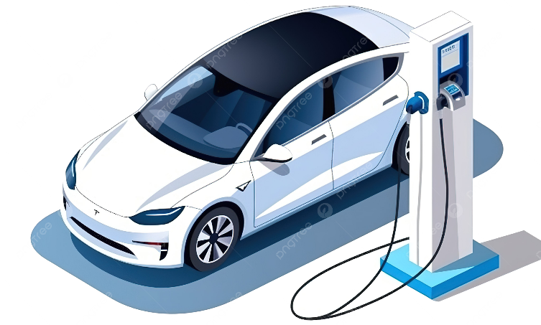




Industry Overview
As global mobility transitions to electric, the market for innovative charging and fleet management solutions is expanding at a CAGR of 25%
The number of EVs across the world is growing at CAGR of 19%
Adoption of EV in the B2B sectors
Key benefits and challenges:
Siemens planning to electrify its feet of 10,000 vehicles
Reduction in cost
Maintenance: 40%
Fuel savings: 60%
Regulatory & compliance future proofing
Already operating 29,000 EVs and planning 60% electrification by 2030
Risk of potential grid strain
Complex charging schedule
Public acceptance of EVs—once uncertain—has reached a tipping point and will continue to grow to ~40 Million EVs worldwide
Key highlight:
Amazon planning to electrify its fleet with 100,000 EVs
87% fleet operations cited need of fleet management software for EVs
Source: Mckinsey Electric vehicles – What’s ahead; Axios, DHL, EV Range

Slide 5

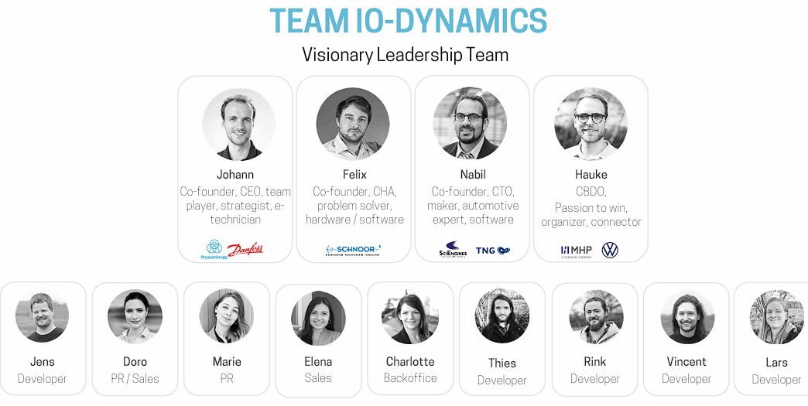










Company Overview
A strong team with diverse leadership and strong technical expertise with proven product market fit
Founded in 2019 by Johann Olsen, Nabil Imran & Felix Kruse in Flensburg, Germany
Mission is to Simplify and accelerate the energy and mobility transition for fleet operators
Geo-operation
Germany
Austria
Switzerland
Company Highlights
Why will this team win
12 + Active Clients
100% Cloud Based
3 founders with > 20 years of experience in tech-driven products
Mission driven and results oriented
5 + Channel Partners
Agnostic Platform
Diverse and complementary leadership
Source: https://www.iodynamics.de/en/press/

Slide 6
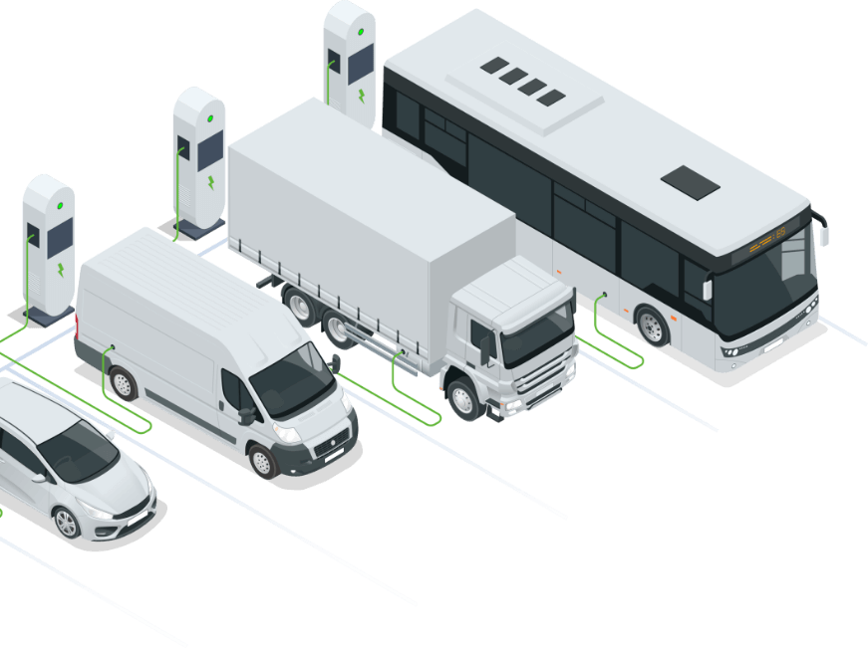
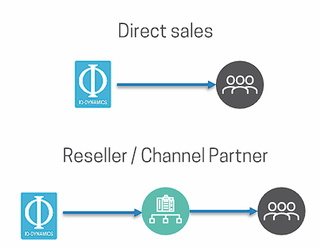


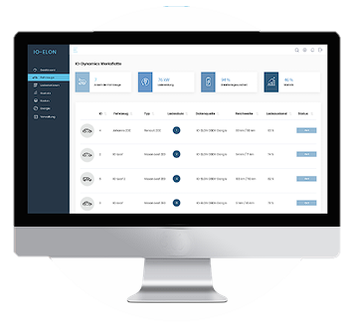
Company Overview
IO Dynamics is functioning in a highly profitable and growing market, with a very sticky and hard to switch product
Global Fleet Electrification Market (Euros)
GTM Strategy
15 B
Target Customer
Distribution Channels
TAM
Fleet-Operating Companies
SAM
1 B
By year 2034
Fleet electrification consultants & integrators
SOM
120 mil
Charging Infrastructure Providers & Installers
Product Highlights
Impact
B2B SaaS product
AI driven decision making
Subscription based
Grid friendly
Easily integrable
Aligns with sustainability goals
Constant revenue streams
High customer retention
Great product market fit

Slide 7
Financial Analysis
IO-Dynamics is lucrative opportunity that aligns with our investment critetria
Start Up Ask
Our Offer
2 Million
Funding Range
5 Million
Raising 5 Million Euros
Highly Diluted Shareholder Structure
10%
Equity Range
21.7%
Valued at 18 Million Euros
(Pre-Money Valuation)

Slide 8



Financial Summary
The key financial metrics reveal a sustainable and robust business model, with high defensibility
Revenue Growth Rate YoY (%)
Customer lifetime Value
Customer lifetime
2025
2026
2027
2028
2029
€1.25 Million
7 Years
CAC
Returns
€3.06 Million
IRR : 44%
Revenue Sensitivity
€2.56 Million
MOIC : 6X
€62,000 through 7 years
€2.34 Million

Slide 9
Synergies
IO-dynamics is a great fit for Evolvia capital
Fund size = 100 Million Euros
Ticket size = 50k – 5Million Euros
Open to Series A investments
Fund life = 12 years
Funding ask = 5Million Euros
Raising series A round
Functioning in a ground breaking tech

Slide 10
Thank you
Any question?

Slide 11
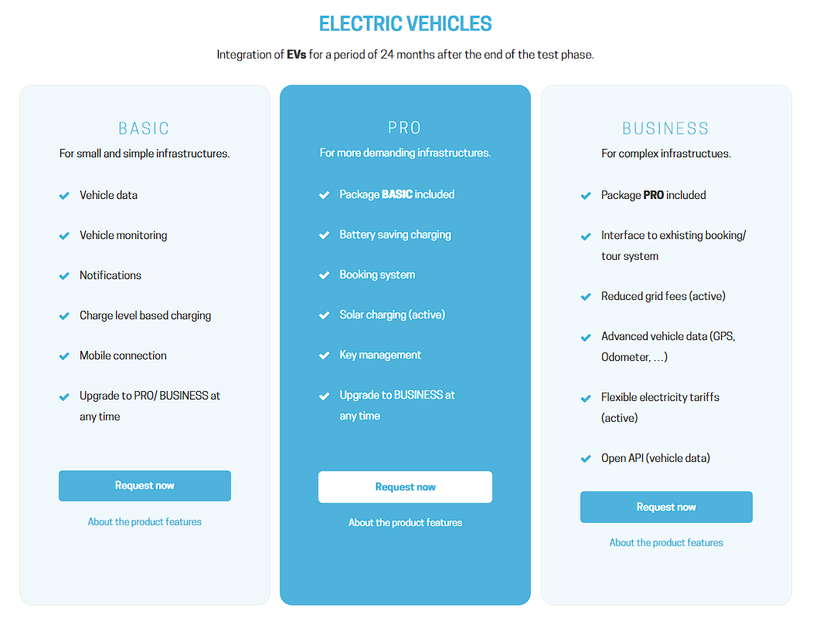
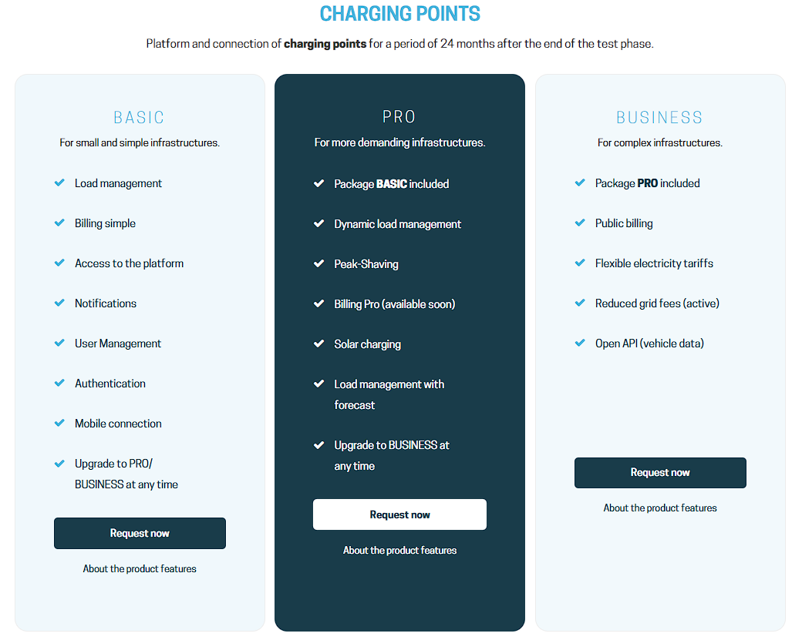
Appendix
IO-Dynamics Subscription Model that Provides a Constant Revenue Stream

Slide 12
Appendix
Problem
Solution
Inconsistent charging performance reduces overall service quality.
Lack of integration leads to operational inefficiencies and security risks.
Poor charging strategies cause high total cost of ownership (TCO) and battery degradation.
Inefficient energy use results in a higher carbon footprint, hurting ESG compliance.
Automated control of all charging processes ensures vehicles are reliably charged and ready for operation.
Cloud-based, unified platform provides full visibility and integration across fleet and charging infrastructure.
Smart charging optimization extends battery life and reduces total energy costs.
Energy source integration (e.g., solar and grid) minimizes carbon footprint and supports sustainability targets
"Scalable Intelligence for Smarter Fleet & Charging Operations"
☁️ Cloud-Based
🔋 Battery Monitoring
🔄 Loading Planning
📊 Real-Time Data
Supports complex operations across multiple locations
Modular and scalable architecture for growing needs
Easy API integration with external services and systems
Prolongs battery life through optimized charging
Detects potential warranty cases early
Maintains high vehicle resale value
Predicts future energy demand for optimal planning
Minimizes energy and operational costs
Ensures efficient use of grid capacity
Enables maximum vehicle availability
Provides real-time incident alerts
Enhances operational transparency

Slide 13
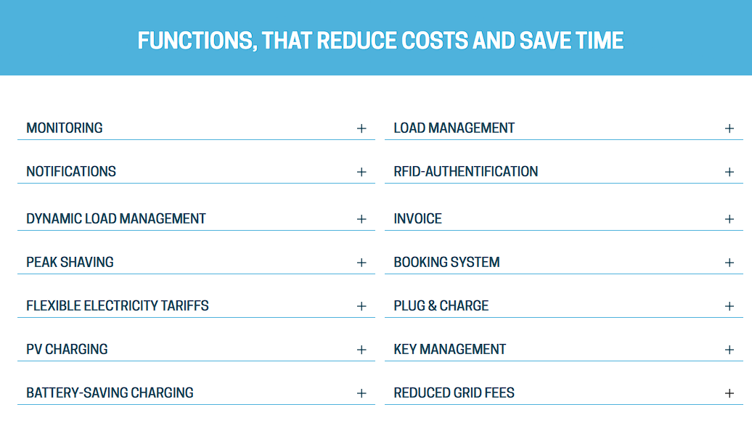
Appendix
IO-dynamics Great features

Slide 14




Company Overview
Fleet Charging Optimization
  About Company
Founded in 2019 by Johann Olsen, Nabil Imran & Felix Kruse in Flensburg, Germany.
Mission: Simplify and accelerate the energy and mobility transition for fleet operators.
Serving companies across Germany, Austria & Switzerland with expansion plans for 2025+.
Enables EV fleet operators to save costs, reduce emissions, and gain operational control.
Cloud software supports all vehicle types, brands, and charging station hardware
Smart and automated charging management that adapts to energy prices, vehicle needs, and grid capacity — reducing peak loads and operating costs.
Cloud-Based Platform
Modular, scalable, and hardware-agnostic SaaS platform with real-time dashboards, automated billing, and open API integration for seamless adoption.
Energy Integration
Optimizes use of solar and renewable energy sources through load forecasting, enabling sustainable and cost-efficient charging operations.
12 + Active Clients
100% Cloud Based
Battery Intelligence
Monitors battery health, extends lifespan, and flags warranty-relevant issues — maximizing TCO and resale value.
5 + Channel Partners
Agnostic Platform

