Slide 1
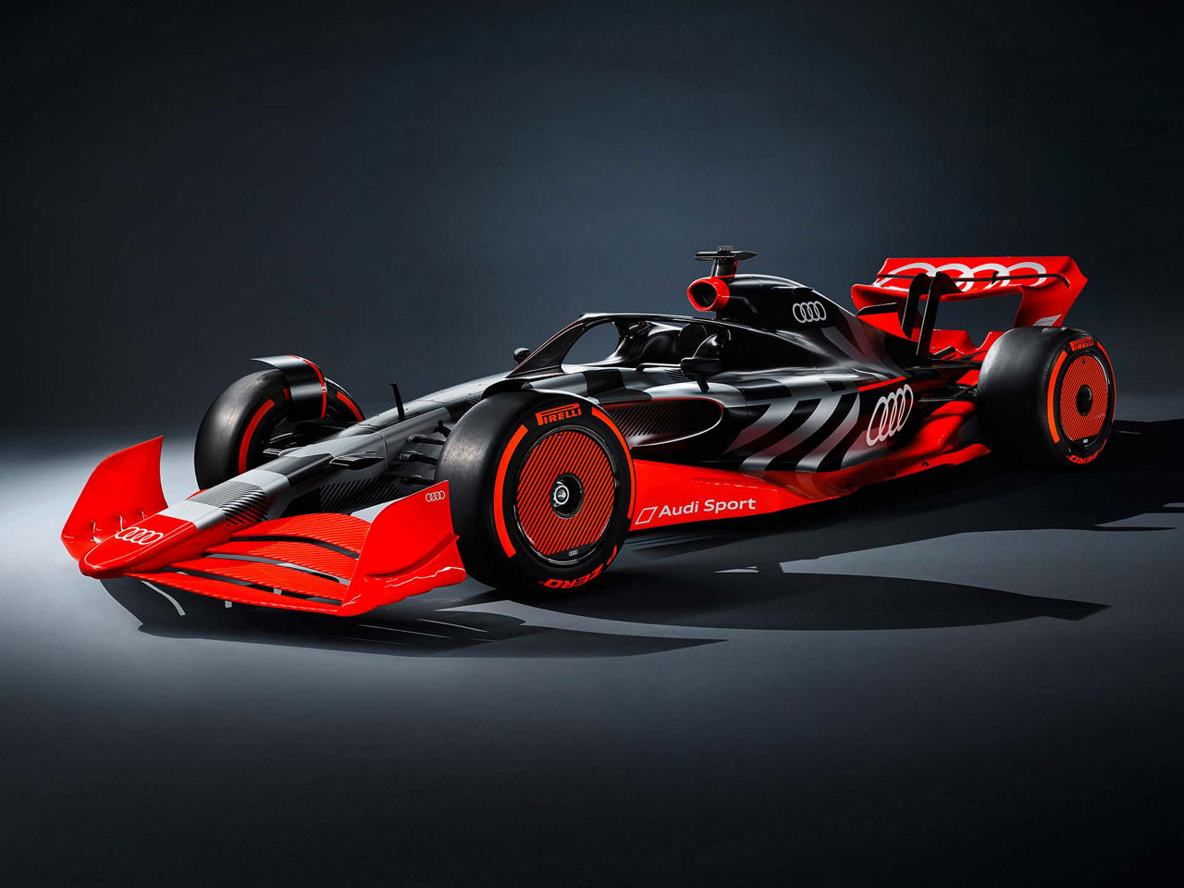







Event Logistics
Audi F1 team
Submitted to: Prof. Dr. Iris Hausladen
Group 9
Nikhil Agarwal
Anamika Das
Shu Chen
Vrinda Mehra

Slide 2

Executive summary
Challenge Overview
The Audi F1 Team faces intense logistics demands, especially during back-to-back races like Japan (Apr 4–6), and Saudi Arabia (Apr 18–20), requiring rapid packing, shipping, and setup across 3 countries and 2 continents in just over 2 weeks.
Critical Risks
Time Constraints: Tight schedules risk delays in car readiness.
Customs Compliance: Varied protocols in China, Japan, Saudi Arabia, USA, and Brazil threaten equipment clearance.
Weather Disruptions: Fog, storms, and monsoons can delay urgent cargo.
Logistics Strategy
Categorized Shipping: Critical items (cars, IT gear) by air; non-critical items via sea in pre-shipped rotating sets.
Stakeholder Coordination: Team logistics, drivers, engineers, and partners (e.g., DHL) collaborate for seamless operations.
Outsourcing Focus: Prioritize global freight, trackside setup, and reverse logistics through ABC analysis.
Key to Success
Proactive planning, contingency strategies, and robust SLAs to mitigate risks and ensure compliance.
"Precision in logistics drives performance on the track."

Slide 3






Introduction
Overview of logistics involved in Formula 1
Formula 1 logistics is the high-speed, global operation that ensures every car, part, and person arrives at the right place, at the right time — across 20+ races, 5 continents, and just 9 months
Massive Movement, Tight Timelines
What’s Moved?
1400+ tons of freight per person
Travel by air (for critical gear), sea (for non-critical cargo), and road
Only days to move everything between races
Race cars, spare parts, IT racks, tools, garage setups
Crew equipment, media kits, hospitality units
Global Planning & Coordination
Customs clearance, weather delays, and tight race calendars demand military-level precision
Some setups begin while another race is still ongoing
Efficient logistics are the foundation of every Grand Prix — without them, the race cannot begin, the cars cannot perform, and the show cannot go on.

Slide 4







Key Challenges
Key Grand Prix Logistics Challenges for Audi F1 Team
Global travel & tight schedule
Rapid Setup and Teardown
Customs and Regulations
Weather disruptions
Tight timelines and long distances pose a major challenge.
Teams must shift from Japan to Bahrain to Saudi Arabia within 15 days.
Back-to-back races in Mexico, Brazil, Las Vegas, and Qatar could create complex air and sea freight coordination issues.
High chance of forgetting Items
Parts are categorized - critical items travel by air, others by sea in multiple sets.
5 sets of non-critical items are sent in advance, rotating them between global races.
One missing tool or component can delay car readiness or compliance checks.
Races spanning China, Japan, Saudi Arabia, USA, and Brazil could bring unique customs protocols.
Audi must maintain compliance and have contingency strategies to avoid delays in equipment clearance.
Weather delays can disrupt transport
Fog in Mexico or storms in Florida can delay urgent air cargo, risking setup time.
High winds or closed tunnels can stop trucks or sea freight unexpectedly.

Slide 5
Role of Logistics in Sports Event Management
Key Focus: Formula 1 Logistics
Complexity and Scale of Operations
F1 teams move around 1,500 tons of gear—cars, tools, and team equipment—across 20+ countries in one season. This requires careful planning and global coordination.
Environmental responsibility
The environmental impact of global logistics is a growing concern. F1 aims for net-zero carbon emissions by 2030, pushing for greener transport methods like biofuels.
Fan expectations & Media Pressure
A smooth operation boosts fan engagement, while any logistical hiccup is instantly broadcasted on social media, risking brand damage.
Time-Sensitive Scheduling
With races often held back-to-back, teams must pack, fly, and set up everything within days—like going from Las Vegas to Abu Dhabi in under a week.
Technological and Logistical Precision
Transporting delicate and high-value equipment, such as cars and their components, demands meticulous handling. Teams need to ensure they arrive in optimal condition and are ready for competition.

Slide 6








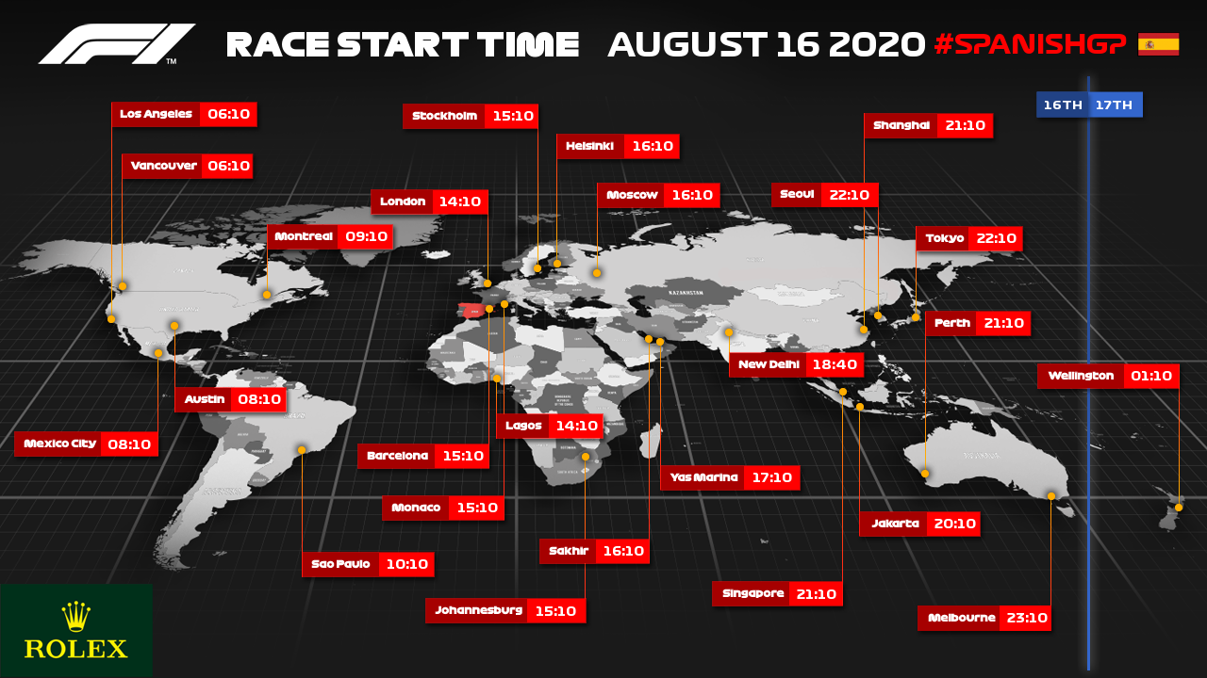
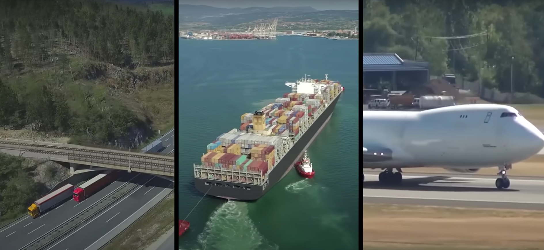

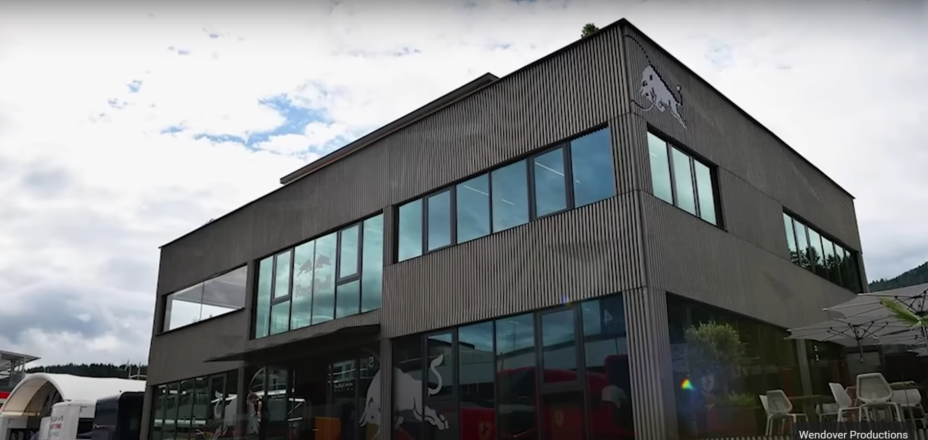
Potential Logistics Tasks for Outsourcing to LSPs
Categorical distribution of Potential Logistics Tasks through ABC Analysis
Global Freight & Customs Handling
Reverse Logistics
A
C
Race Equipment Transportation
Catering & Hospitality Logistics
Last-Mile Urgent Deliveries
Sustainable Logistics Solutions
IT Equipment & Data Logistics
Trackside Setup & Dismantling
B
Temporary Warehousing Nearby
Personal Travel & Accommodation

Slide 7







Selecting the Best LSP for Audi F1 Logistics
To define the challenges and scope
Audi F1 requires a logistics partner capable of managing global, time-critical, and sustainability-driven operations across 20+ Grand Prix events.
International Transport (air/sea/road)
Outsourced Tasks
Reverse Logistics
On-Site Race Logistics (setup, teardown, storage)
Merchandise & Promo Logistics
Spare Parts & Equipment Handling
Sustainability Consulting
Customs Clearance & Documentation
The goal is to select a logistics partner who can deliver flawlessly, adapt under pressure, and contribute to Audi’s net-zero ambition.

Slide 8


















LSP Selection Procedure: Step-by-Step Framework
What’s the process to find the best?
Define Scope & Needs
Set Requirements & KPIs
Market Research & Longlist
RFI / RFP Rounds
Task breakdown + internal interviews
On-time delivery, sustainability, crisis readiness
Global players + motorsport specialists
Filter, compare offers, validate claims
Audit & Site Visits
Evaluation via Scoring Model
Inspect systems, CO₂ practices, real-time tracking
Use Multi-Criteria Decision Analysis to quantify strengths

Slide 9

Multi-Criteria Decision Matrix (MCDA)
The metrics of evaluation model
Criteria | Weight (%) | Why it matters
Sustainability (CO₂, circularity) | 20% | Audi F1’s green agenda
Delivery performance (OTD, lead time) | 15% | Can’t afford delays
Cost efficiency | 15% | Value over lowest price
Experience in motorsport | 15% | Speed, secrecy, reliability
Tech capabilities (API, tracking) | 10% | Real-time visibility
Crisis flexibility | 10% | Customs delays, rerouting
Reputation | 5% | References, case studies
Financial stability | 5% | No collapse mid-season
Innovation potential | 5% | Forward-looking partners
We prioritize sustainability and F1-specific expertise over lowest-cost offers.

Slide 10







Strategic Partner Selection: Criteria for Logistics Excellence
Streamline Success: Key Logistics Tasks to Outsource for Peak Performance
On-time Delivery
Damage-Free delivery
Sustainability Compliance
Scope: Spare parts, race equipment, tools, gear, and sponsor materials
Justification: A single delayed delivery can compromise race performance or violate regulations
Scope: Correct quantity, type, and condition of race-critical components delivered
Justification: Miss deliveries (e.g., wrong tire compounds or tools) can jeopardize pit operations
Scope: Shipping, warehousing, last-mile delivery.
Justification: Audi F1’s no fossil fuel vision and circular economy commitment
Accuracy in Inventory & Order Fulfilment
Real-Time tracking availability
Issue resolution response time
Custom clearance efficiency
Scope: Correct quantity, type, and condition of race-critical components delivered.
Justification: Miss deliveries (e.g., wrong tire compounds or tools) can jeopardize pit operations.
Scope: Lost, or delayed goods; customs issue; incorrect deliveries.
Justification: Quick response time minimizes operational risks.
Scope: All cross-border freight for F1 events
Justification: Formula 1’s global circuit necessitates seamless cross-border movement
Scope: Full supply chain visibility (including in-transit location, ETA, customs status).
Justification: Essential for race preparation and agile response to disruptions.

Slide 11
Service Level Agreements (SLAs) & Monitoring
SLAs That Deliver: Ensuring Excellence Through Rigorous Monitoring
KPI Dashboards
- Real-time dashboard tracking using SLA metrics
- Built on ICT systems (ERP/SCM integrated with IoT for asset tracking)
Penalty & Incentive Structure
- Financial penalties for non-compliance (e.g., late deliveries)
- Bonuses for exceeding benchmarks
Weekly performance Reports
Automated reports highlighting compliance, deviations, and root causes
Site Audits & Spot Checks
On-site verification of packaging, loading practices, and warehouse conditions at key locations
Regular Review Meetings
Monthly or post-race review sessions with the LSP to evaluate performance and plan improvements
Feedback Loops
Internal team feedback (e.g., race engineers, pit crew) on logistical sufficiency and performance

Slide 12
References
https://www.businessinsider.com/how-formula-one-team-transports-drivers-cars-staff-world-season-2023-11
https://www.grandprix247.com/2023/12/20/logistics-behind-f1-how-formula-one-moves-around-the-world/
https://www.freightwaves.com/news/the-extreme-logistics-behind-formula-ones-global-circus
https://f1destinations.com/the-logistics-of-formula-1/
https://www.crash.net/f1/news/1028168/1/mindblowing-logistics-how-f1-flies-20-hours-las-vegas-abu-dhabi
https://www.youtube.com/watch?v=IdzfJMyZTZU
https://www.youtube.com/watch?v=vFsHHuTtXC0
https://www.youtube.com/watch?v=6OLVFa8YRfM
https://www.youtube.com/watch?v=9DTpQ8LGE2c
https://www.youtube.com/watch?v=FYz5bxZJUgU

Slide 13

Thank you

